Slide 1


Rory Byrne, rbyrne@cct.ie

Slide 2
Key areas
In this section we are going to discuss:
The concept of sampling –
a sample is a representative proportion of the relevant population
Risks involved in sampling
Difference between Sample and Population
Sampling Methods, Types and Size

Slide 3
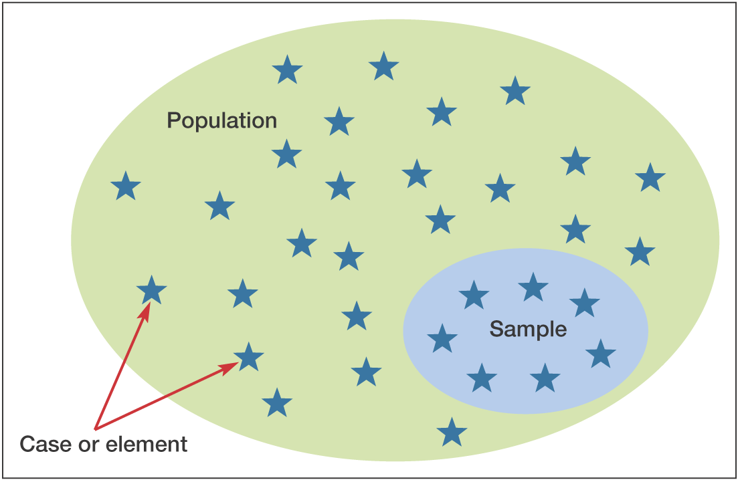
Figure 7.1 Population, sample and individual cases

Slide 4
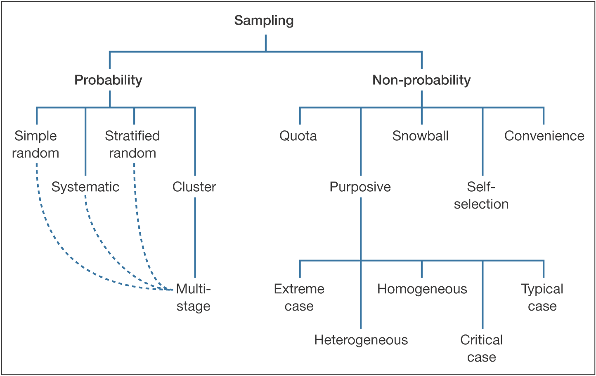
Figure 7.2 Sampling techniques

Slide 5
Sampling Methods
There are 2 methods in sampling:
Probability sampling
A probability sampling scheme is one in which every unit in the population has a chance (greater than zero) of being selected in the sample, and this probability can be accurately determined. The combination of these traits makes it possible to produce unbiased estimates of population totals, by weighting sampled units according to their probability of selection

Slide 6
Sampling Methods
There are 2 methods in sampling:
Non probability sampling
Non probability sampling is any sampling method where some elements of the population have no chance of selection (these are sometimes referred to as 'out of coverage'/'undercovered'), or where the probability of selection can't be accurately determined. It involves the selection of elements based on assumptions regarding the population of interest, which forms the criteria for selection. Bias is inherent in this method.

Slide 7
Sampling Types –
Your choice of Sampling Type will depend entirely on your choice of Sampling Method (ie Probability or Non Probability.)

Slide 8
Sampling Types – Probability
A simple random sample is selected so that all samples of the same size have an equal chance of being selected from the entire population.
Example: The lotto.ie
https://www.thejournal.ie/the-explainer-lotto-podcast-rollover-5624766-Dec2021/

Slide 9
Sampling Types - Probability
Systematic sampling is a statistical method involving the selection of elements from an ordered sampling frame. The most common form of systematic sampling is an equal-probability method, in which every k^{th} element in the frame is selected, where k, the sampling interval (sometimes known as the skip) is identified.
This is simple random sampling but with a system
Example: Suppose a supermarket wants to study buying habits of their in-store customers, then using systematic sampling they can choose every 5th or 10th customer entering the supermarket and conduct the study on this sample.

Slide 10
Sampling Types - Probability
A housing estate has recently had all of it’s greens and free parking spaces enhanced and maintained. The company who carried out the work is keen to survey a representative sample to collect valid feedback. The housing estate consists of 1 bed apartments, 2, 3, 4 -bed houses and a limited number of 5 bed houses.
Q- should they apply simple random or systematic random approach here?

Slide 11
Sampling Types - Probability
In statistical surveys, when subpopulations within an overall population vary, it is advantageous to sample each subpopulation (stratum/segment) independently. Stratification is the process of dividing members of the population into homogeneous subgroups before sampling. The strata should be mutually exclusive: every element in the population must be assigned to only one stratum. The strata should also be collectively exhaustive: no population element can be excluded. Then simple random or systematic sampling is applied within each stratum. This often improves the representativeness of the sample by reducing sampling error. It can produce a weighted mean that has less variability than the arithmetic mean of a simple random sample of the population.
A real-world example of using stratified sampling would be for a political survey. Voters are asked how did the Government handle the pandemic. Voters would be put into which strata initially?
A second example would be where a hospital wants to survey an A & E patient’s service experience on the basis of if the patient presents with Covid-19 or not.

Slide 12
Sampling Types – Non Probability
Convenience sampling is a type of non probability sampling which involves the sample being drawn from that part of the population which is close to hand. That is, a population is selected because it is readily available and convenient.
Judgment sampling is a common non probability method. The researcher selects the sample based on their judgment. For example, a researcher may select an expert in a field for a depth interview. When using this method, the researcher must be confident that the chosen sample is truly representative of the entire population.

Slide 13
Sampling Types – Non Probability
Snowball Sampling
The process of snowball sampling is much like asking your subjects to nominate another person with the same trait as your next subject. The researcher then observes the nominated subjects and continues in the same way until the obtaining sufficient number of subjects. This approach is an extension of judgment sampling. It can carry significant pitfalls so caution is required at both selection stage and data validity stage.

Slide 14
Sampling Types – Non Probability
Quota sampling
In quota sampling, the population is first segmented into mutually exclusive sub-groups, just as in stratified sampling. Then judgment is used to select the subjects or units from each segment based on a specified proportion. For example, an interviewer may be told to sample 200 females and 300 males between the age of 45 and 60.

Slide 15
Sampling Types – Non Probability
Purposive Sampling
Purposive sampling targets a particular group of people. When the desired population for the study is rare or very difficult to locate and recruit for a study, purposive sampling may be the only option. For example, you are interested in researching recovery periods for patients who are recuperating from long Covid. This could be a difficult population to find and to verify.
Your city has a well-established rehabilitation hospital and you contact the director to ask permission to recruit from this population. The major problem with purposive sampling is that the type of people who are available for study may be different from those in the population who can't be located and this might introduce a source of bias.

Slide 16
Sampling Types – Non Probability
Purposive Sampling
Purposeful sampling is a technique widely used in qualitative research for the identification and selection of information-rich cases for the most effective use of limited resources (Patton, 2002). This involves identifying and selecting individuals or groups of individuals that are especially knowledgeable about or experienced with a phenomenon of interest (Cresswell & Plano Clark, 2011). In addition to knowledge and experience, Bernard (2002) and Spradley (1979) note the importance of availability and willingness to participate, and the ability to communicate experiences and opinions in an articulate, expressive, and reflective manner.

Slide 17
Sampling within the MRP
Your choice of Sampling Method and Sampling Type will play an important role of your selection of primary research tool.
Probability sampling works closely with quantitative research methods
Non-probability sampling works closely with qualitative research methods.

Slide 18
Sampling Error
What Is a Sampling Error? A sampling error is a statistical error that occurs when the researcher does not select a sample that represents the entire population of data. As a result, the results found in the sample do not represent the results that would be obtained from the entire population. It has the potential to invalidate the findings gathered (often at significant time and expense to the researcher/client).

Slide 19
Margin of Error
What is a Margin of Error?
A margin of error tells you how many percentage points your results will differ from the real population value. For example, a 95% confidence interval with a 4 percent margin of error means that your statistic will be within 4 percentage points of the real population value 95% of the time.
More technically, the margin of error is the range of values below and above the sample statistic in a confidence interval. The confidence interval is a way to show what the uncertainty is with a certain statistic (i.e. from a poll or survey).
For example, a poll might state that there is a 98% confidence interval of 4.88 and 5.26. That means if the poll is repeated using the same techniques, 98% of the time the true population parameter (parameter vs. statistic) will fall within the interval estimates (i.e. between 4.88 and 5.26) 98% of the time.
https://www.statisticshowto.com/probability-and-statistics/hypothesis-testing/margin-of-error/

Slide 20
Margin of Error
Statistics Aren’t Always Right!
Margins of error are commonly used in election polls.
The idea behind confidence levels and margins of error is that any survey or poll will differ from the true population by a certain amount. However, confidence intervals and margins of error reflect the fact that there is room for error, so although 95% or 98% confidence with a 2 percent Margin of Error might sound like a very good statistic, room for error is built in, which means sometimes statistics are wrong.
https://www.statisticshowto.com/probability-and-statistics/hypothesis-testing/margin-of-error/

Slide 21
Sampling in relation to your
DA Project – the takeaways
You will be required to identify a sampling method and a sampling type in your Research Proposal. It is not unusual that you may amend this before you commence work on your project as you may identify different populations to which to base your work on/or we may advise an alternative approach is required.
You are not required to calculate the margin of error or to statistically calculate an optimal sample size. (These are not in the LOs for this programme).
Be careful – failure to apply the correct sampling strategy (ie method and type) can lead to your entire piece of work being rejected due to it being invalid. The purpose of the RP is to enable us to assist you in identifying the correct strategy to select.
Where you do not feel a sampling strategy is applicable to your specific project, you are expected to explain clearly what approach you will take. Justification will be required.
Finally – advice - be careful to view sampling as part of the bigger MRP.

